Slide 1
IMPACT OF COVID-19 ON THE HOUSING RENTAL MARKET, RECOMMEND INTERVENTIONS, POTENTIAL MARKETS FOR AFFORDABLE RENTAL HOUSING MARKET WITHIN GAUTENG AND BENCHMARK THE GPF PORTFOLIO
DRAFT REPORT PRESENTATION
MARCH 2023

Slide 2
CONTENT
WHO IS URBAN-ECON
INTRODUCTION & APPROACH
STUDY AREA
MARKET DRIVERS AND TRENDS
POTENTIAL MARKET DEMAND
INDUSTRY INTERVIEWS
GPF PORTFOLIO REVIEW
PROPOSED NEW TREND AREAS
RECOMMENDATIONS

Slide 3
1 . WHO IS UE PROPERTY DEVELOPMENT SERVICES
Urban-Econ is the leading market research company is South Africa
PDS Unit comprises of registered property specialists
Have executed ground-breaking research on the economics of the property market.
Customised techniques for research & application
Cover all property market segments and sectors

Slide 4
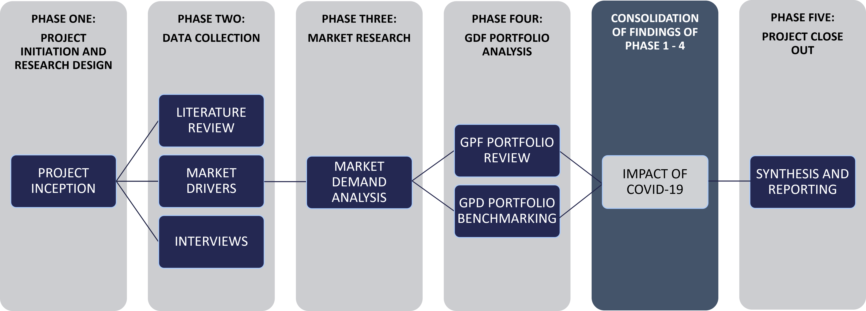
2 . INTRODUCTION & APPROACH
Purpose: a review of a study on the impact of COVID-19 on the affordable rental housing market.
Study objectives:
Impact of COVID-19 on the property sector and new trends and stimulation packages
Economic drivers and trends, demographic profile and development and growth of trade areas
Potential new emerging areas for investment and appropriate product
Comprehensive market study is required to estimate the residential potential of these areas
Provide feedback on the relevance of the GPF’s products in the market

Slide 5
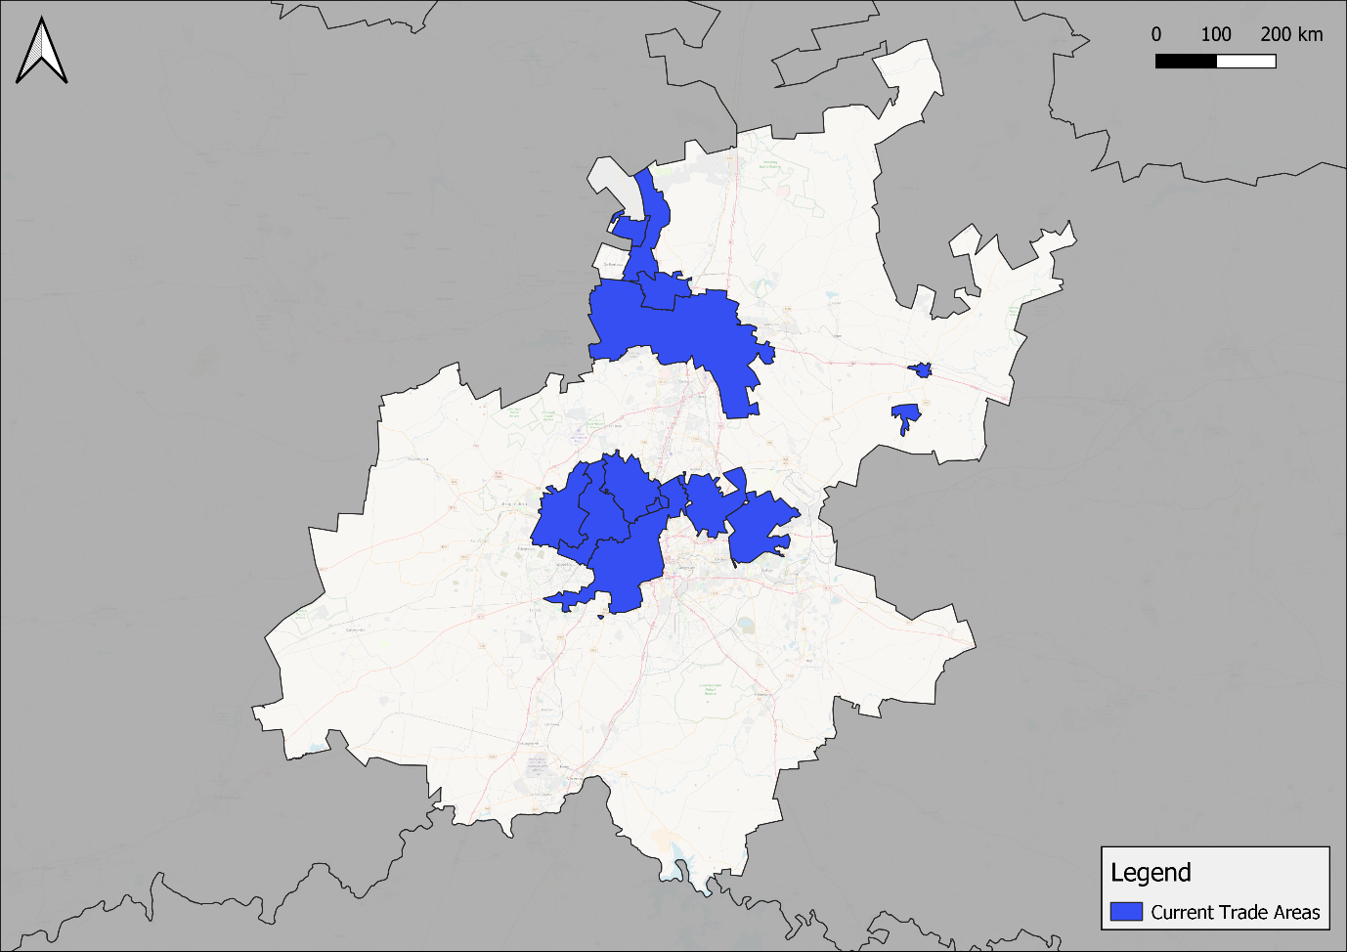
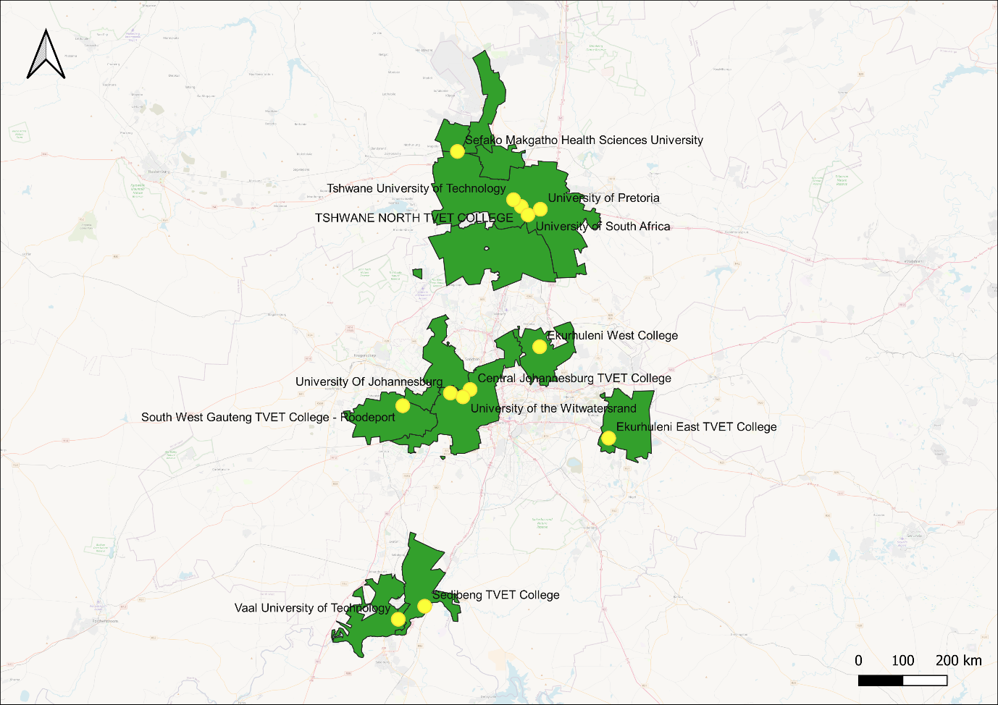
3. STUDY AREA
Affordable Housing Trade Areas
Student Accommodation Trade Areas
Pretoria North
Pretoria CBD
Randburg CBD and Surrounds
Bronkhorstspruit
Kempton Park
Benoni
Johannesburg CBD

Slide 6
4. MARKET DRIVERS AND TRENDS
ECONOMIC AND SOCIO-DEMOGRAPHIC PROFILE
General economic growth in GVA in Gauteng with a slowdown from 2019
Increase in population at average of 2,55% population and 2,62% household growth rate
Most of the population in the trade areas have some secondary education or Grade 12.
Significant potentially economically active population
The largest portion of the population falls within the low-income range
AFFORDABLE HOUSING MARKET TRENDS
STUDENT HOUSING MARKET TRENDS
The most prominent dwelling typology across all trade areas is house on a separate stand.
Areas with preference of bonded & rental housing
Unit size & Rental price
Key amenities: parking, Wi-Fi, security
Rent mostly includes levies, electricity and water
COVID-19 impacts
Decreasing performance in rental housing in GP
General decrease in enrolments between 2018 and 2020
On-campus student accommodation
Private student accommodation
Average rental rates range from R3 500 to more that 5 500
High occupancy levels due to insufficient supply – up to 98%
Decrease in escalation after COVID-19

Slide 7
5. POTENTIAL MARKET DEMAND
AFFORDABLE & STUDENT HOUSING MARKET DEMAND
 | CRU | SOCIAL HOUSING |  | AFFORDABLE HOUSING
 |  | PRIMARY MARKET | SECONDARY MARKET
 | Randburg
2023 | 473 | 871 | 520 | 672
2030 | 4 210 | 8 445 | 6 258 | 5 978
 | Pretoria CBD
2023 | 247 | 462 | 500 | 669
2030 | 2 175 | 4 073 | 4 409 | 5 898
 | Pretoria North
2023 | 168 | 252 | 183 | 162
2030 | 1 481 | 2 224 | 1 616 | 1 430
 | Bronkhorstspruit
2023 | 3 | 5 | 6 | 8
2030 | 24 | 41 | 54 | 70
 | Johannesburg CBD
2023 | 1 155 | 2 105 | 1 535 | 1 018
2030 | 10 272 | 18 729 | 13 653 | 9 058
 | Benoni
2023 | 53 | 84 | 68 | 69
2030 | 466 | 732 | 594 | 597
 | Kempton Park
2023 | 31 | 56 | 74 | 101
2030 | 266 | 489 | 645 | 877
Student Accommodation
 | 2023 | 2025 | 2028 | 2030 | 2033 | 2035
Randburg | 540 | 366 | 204 | 138 | 77 | 52
Pretoria CBD | 5 713 | 3 362 | 3 031 | 2 910 | 2 815 | 2 790
Pretoria North | 2 294 | 1 545 | 1 498 | 1 507 | 1 559 | 1 614
Johannesburg CBD | 3 979 | 3 847 | 3 791 | 3 777 | 3 786 | 3 808
Benoni | 637 | 633 | 628 | 625 | 620 | 616
Kempton Park | 222 | 171 | 115 | 89 | 60 | 46
Vaal | 2 041 | 1 659 | 1 887 | 2 068 | 2 391 | 2 645

Slide 8
6. INDUSTRY INTERVIEWS
Purpose to gain insight on the on the market dynamics and impact of COVID-19 in the rental housing market
Question-guided discussions were conducted
Face-to-face and telephonic/e-meeting interviews with stakeholders
Property Owners
Financial Institutions
Financial Advisory
Credit Bureau
Government
Property Developers
Asset Managers
Agents & Brokers

Slide 9
6.INDUSTRY INTERVIEWS
Impact of COVID 19 on rental housing
Vacancies increased and still recovering
Limited Tenant affordability
Property businesses/landlord struggled to sustain businesses
Impact of COVID 19 on property sector
Disruption of sector performance
Halted and then delayed construction – delays in production, projects and developments
Financial limitations
Future development patterns and market changes due to the Covid-19 pandemic
Long road to recovery in the private property sector
Significant growth in the residential sector
Increased budgets to finance housing projects
Review and changes in housing policies
Pre-COVID-19 market performance
Good performance
Better vacancy rates/occupancies
Industry Interviews
Prevailing and future market drivers and trends
High competition levels
Limited rental income and financial limitations as property businesses recover
Risks
Unfavourable economic conditions
Increases in prices
Decrease in demand

Slide 10
7. GPF PORTFOLIO REVIEW
Rental Housing Development Profile
Operational Expenses
Vacancies
Bad Debt
12 Developments
Affordable
1 development – 7
Social Housing:
5 developments
Bachelor – 2 bedroom
119 – 540 units
Student housing:
6 developments
1 – 3 bedroom
20 – 94 units
Very few indicated the bad debt values
Respondents indicated reasons for information
Does not have bad debt - NSFAS-accredited
Still under construction
No figures recorded
Only two developers provided bad debt figures
Indicated value of bad debt amounts to roughly 1% of total annual income.
Rand per unit
Affordable & Social:
Bachelor – R1 537,67
1 bed – R1 680,00
2 bed – R1 760,00
Unspecified – R2 627,33
Student housing:
1 bed – R5 441,00
2 bed – R5 334,25
3 bed – R12 000,00
Unspecified – R5 217,00
Student housing:
Mostly 0%
Between 21% & 41% for some
Under construction – 100%
Social Housing:
Very low – 1 – 8%
Some 22%
Under construction – 100%
Affordable Rental:
Only 1 indicated – 3%

Slide 11
8. PROPOSED NEW TRADE AREAS
AFFORDABLE HOUSING
STUDENT ACCOMMODATION
SUGGESTED NEW TRADE AREA | LOCAL MUNICIPALITY
Kya Sand | City of Johannesburg
Laser Park | City of Johannesburg
Joburg CBD | City of Johannesburg
Midrand | City of Johannesburg
Akasia | City of Tshwane
Daspoort | City of Tshwane
Les Marais | City of Tshwane
Rosslyn | City of Tshwane
Kempton Park | Ekurhuleni
Vosloorus | Ekurhuleni
SUGGESTED NEW TRADE AREA | LOCAL MUNICIPALITY
Vanderbijlpark | Emfuleni
Vereeniging | Emfuleni
Sharpeville | Emfuleni
Springs | Ekurhuleni
Kwa-Thema | Ekurhuleni
Johannesburg | City of Johannesburg
Soweto | City of Johannesburg
Soshanguve | City of Tshwane
Ga-Rankuwa | City of Tshwane
Pretoria | City of Tshwane
Akasia | City of Tshwane
Centurion | City of Tshwane
“NO-GO AREAS
Affordable Housing | Student Housing
Bronkhorstspruit | Randburg
 | Bronkhorstspruit
 | Kempton Park

Slide 12
9. RECOMMENDATIONS
High levels of support are required for the rental housing market to recover from the COVID-19 impacts:
Efficient funding structure
Incentives and pardons for companies that contribute to the provision of affordable housing
Policy that addresses the unique challenges and changes
Integration with other development sector stakeholders in the property sectors
A review of the defining features of the Social and Affordable rental housing market affordability levels
Further localised market feasibility studies should be conducted to understand more localised dynamics of trade areas and proposed areas
The potential demand figures determined for social, affordable and student housing should not be exceeded to avoid oversupply.

